Slide 1

Approaches to General Education
Harry Lewis
Harvard University

Slide 2
How specialized should a university education be?

Slide 5
vs.

Slide 7
Universities Create Experts

Slide 8
Universities Create Experts

Slide 9
Universities Create Departments of Experts

Slide 10
Universities Create Departments of Experts

Slide 11
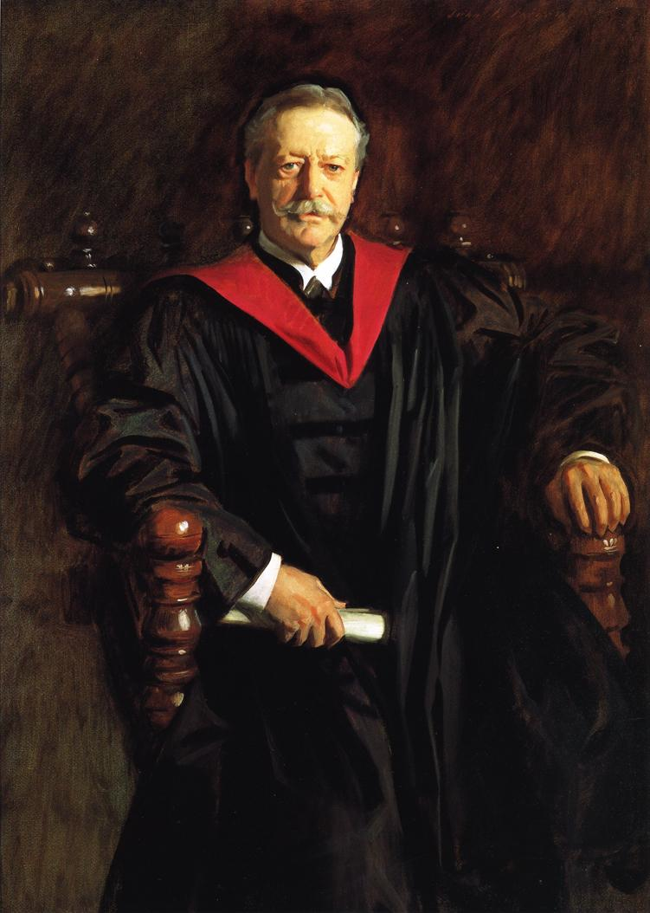
The object of the undergraduate department is not to produce hermits, each imprisoned in the cell of his own intellectual pursuits. – A. Lawrence Lowell

Slide 12
“The best type of liberal education in our complex modern world aims at producing men who know a little of everything and something well.” – A. Lawrence Lowell

Slide 14
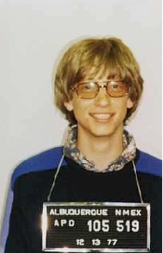
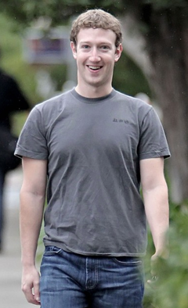

Slide 15


??

Slide 16
General Education Supports the Full Development of the Individual

Slide 17
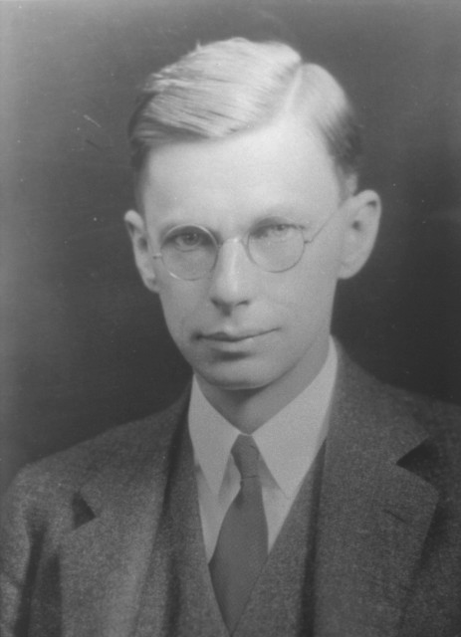
James Bryant Conant
“Education is what is left after all that has been learnt is forgotten.”

Slide 18
General Education Supports the Full Development of the Individual.
General Education is Moral.

Slide 19
A recent Harvard graduate
“I thought there was usually a pretty clear normative argument running through the courses I took. I felt there was an underlying sense of what we should believe about environmental values and the state of the world, what facts and skills we should have to understand Environmental Science and Public Policy in a coherent fashion, and also what kind of personal and professional responses we should develop to what we had learnt (i.e., there were ways of being responsible and ways to be irresponsible).

Slide 20
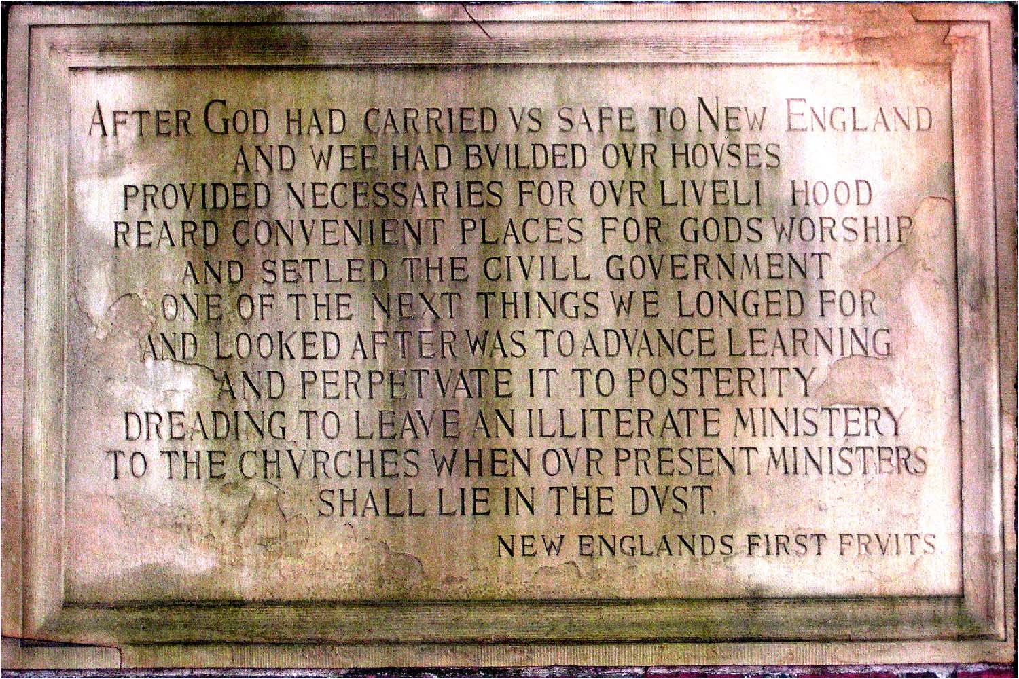
1640

Slide 21
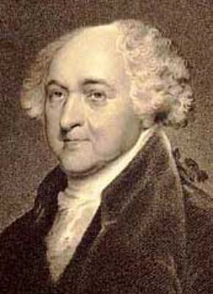
Massachusetts Constitution (1780)
John Adams
Wisdom, and knowledge, as well as virtue, diffused generally among the body of the people, being necessary for the preservation of their rights and liberties;
and as these depend on spreading the opportunities and advantages of education in the various parts of the country, and among the different orders of the people, …

Slide 22
Massachusetts Constitution (1780)
it shall be the duty of legislatures and magistrates, in all future periods of this commonwealth,
to cherish the interests of literature and the sciences, and all seminaries of them; …
to encourage … the promotion of agriculture, arts, sciences, commerce, trades, manufactures, and a natural history of the country;
to countenance and inculcate
  the principles of humanity and general benevolence,
  public and private charity,
  industry and frugality,
  honesty and punctuality in their dealings;
  sincerity, good humor, and all social affections, and
  generous sentiments among the people.

Slide 23
Massachusetts Constitution (1780)
John Adams
Wisdom, and knowledge, as well as virtue, diffused generally among the body of the people, being necessary for the preservation of their rights and liberties;
and as these depend on spreading the opportunities and advantages of education in the various parts of the country, and among the different orders of the people, …

Slide 24
Massachusetts Constitution (1780)
it shall be the duty of legislatures and magistrates, in all future periods of this commonwealth,
to cherish the interests of literature and the sciences, and all seminaries of them; …
to encourage … the promotion of agriculture, arts, sciences, commerce, trades, manufactures, and a natural history of the country;
to countenance and inculcate
  the principles of humanity and general benevolence,
  public and private charity,
  industry and frugality,
  honesty and punctuality in their dealings;
  sincerity, good humor, and all social affections, and
  generous sentiments among the people.

Slide 25

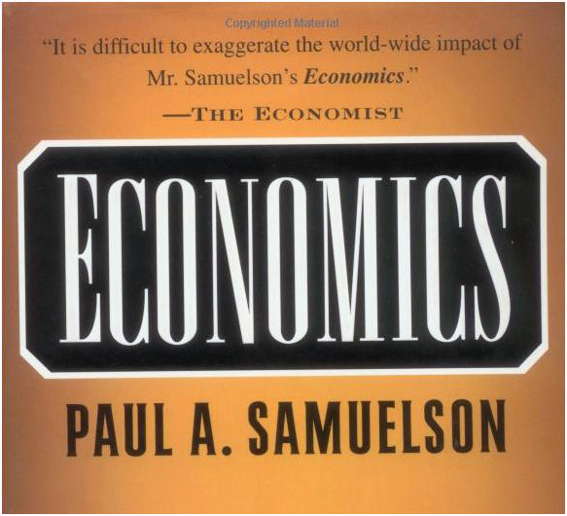

Slide 26

“Greed is Good”

Slide 27
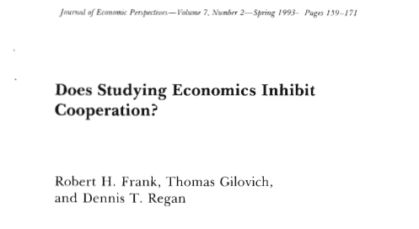

Slide 28
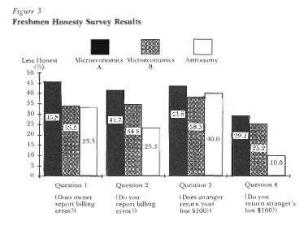

Slide 29
Massachusetts Constitution (1780)
John Adams
Wisdom, and knowledge, as well as virtue, diffused generally among the body of the people, being necessary for the preservation of their rights and liberties;

Slide 31
Spirit of Learning (Wilson, 1909)
Power to distinguish good reasoning from bad
Power to digest and interpret evidence
Habit of catholic observation
Preference for a non-partisan point of view
Clear and logical processes of thought
Instinctive desire to interpret rather than stick to the letter of the reasoning
Taste for knowledge
Deep respect for the integrity of the human mind

Slide 32
Spirit of Learning (Wilson, 1909)
“It is citizenship in the world of knowledge, not ownership of it.”

Slide 33
We are faced with a diversity of education which, if it has many virtues, nevertheless works against the good of society by helping to destroy the common ground of training and outlook on which any society depends.

Slide 34
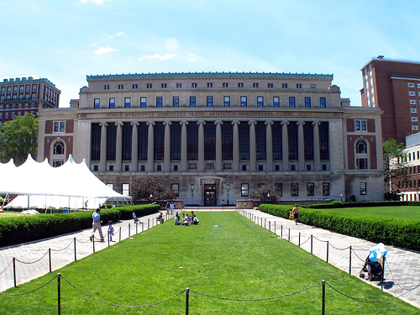
Columbia (1920s)

Slide 35
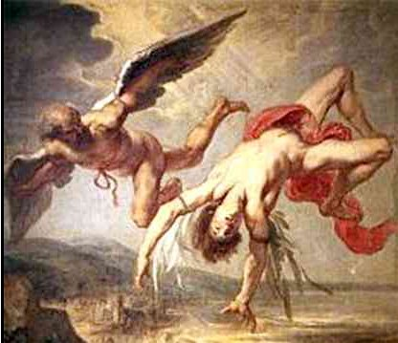
“In medio tutissimus ibis”

Slide 36
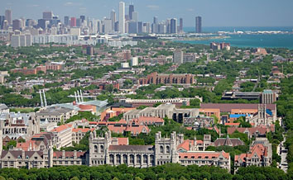
Chicago (1930s)

Slide 37
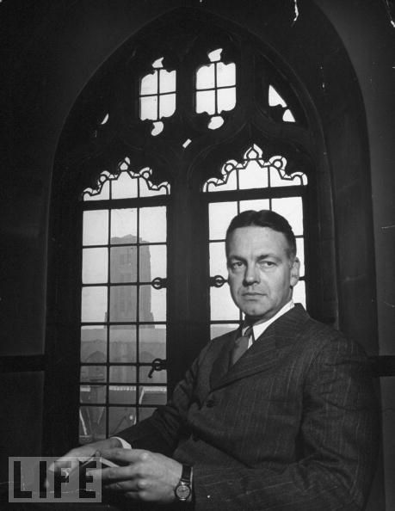
Robert Maynard Hutchins

Slide 38
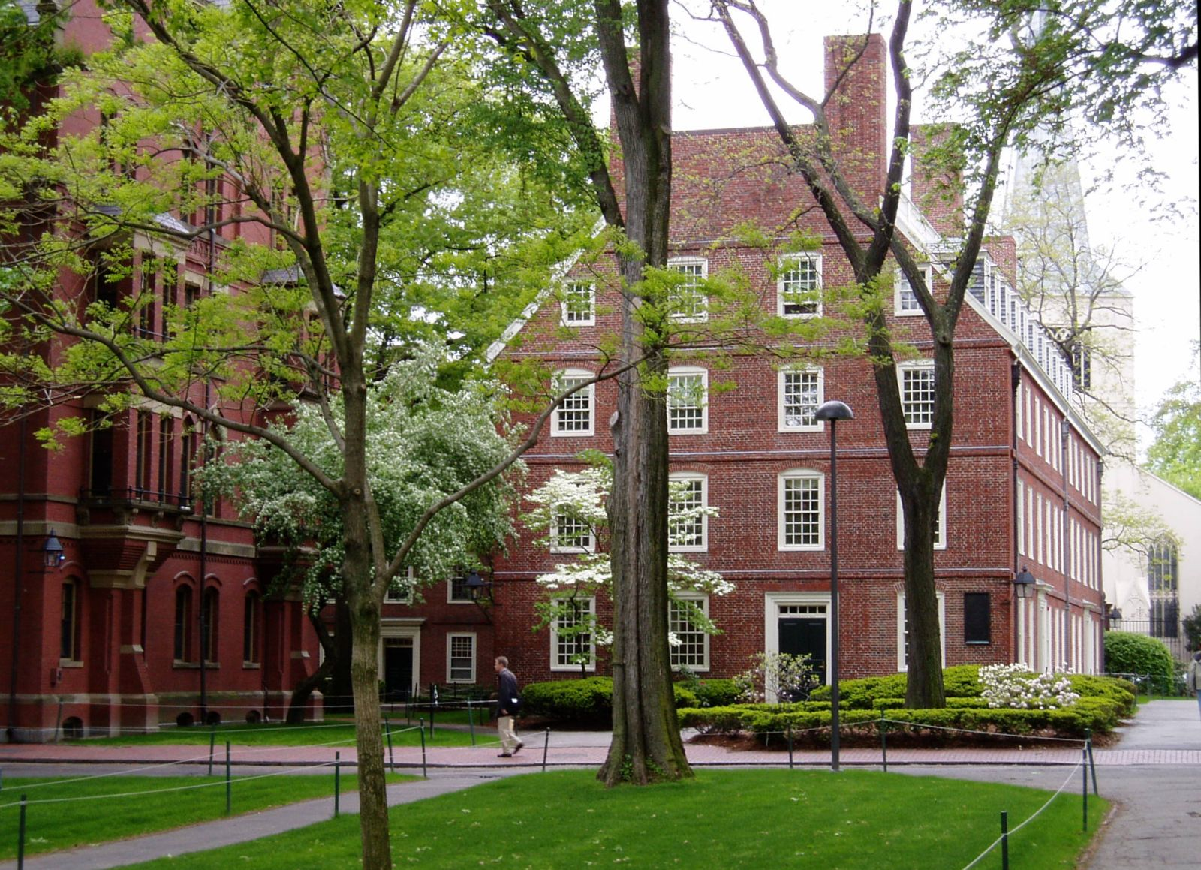
Harvard (1940s)

Slide 39
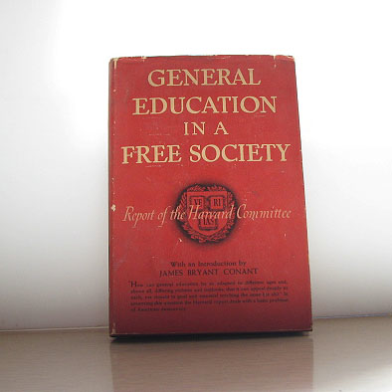

Slide 40
Harvard (1940s)
The heart of the problem of a general education is the continuance of the liberal and humane tradition. Neither the mere acquisition of information nor the development of special skills and talents can give the broad basis of understanding which is essential if our civilization is to be preserved – Conant

Slide 41
Harvard (1940s)
“Life as a responsible human being and citizen”
“traits of mind and ways of looking at man and the world”

Slide 42
The Harvard “Core” (1970s)
“Approaches to knowledge”
“Skills and modes of thought”

Slide 43
The New Harvard General Education Curriculum (2000s)
“Seeks to connect in an explicit way what students learn in Harvard classrooms to life outside the ivied walls and beyond the college years”

Slide 44
New Harvard Gen Ed Program
“Aesthetic and Interpretive Understanding”
“Culture and Belief”
“United States in the World”
“Societies of the World”
“Science of Living Systems”
“Science of the Physical Universe”
“Empirical and Mathematical Reasoning”
“Ethical Reasoning”

Slide 45
General Education
A Convincing Story about its Importance
Idealism
Framed around questions, not answers

Slide 46
General Education
A Convincing Story about its Importance
Idealism
Framed around questions, not answers
Balance between societal traditions and human universals

Slide 47
General Education
A Convincing Story about its Importance
Idealism
Framed around questions, not answers
Balance between societal traditions and human universals
Power and activism

Slide 48
Hear and you forget; see and you remember; do and you understand

Slide 49
General Education
A Convincing Story about its Importance
Idealism
Framed around questions, not answers
Balance between societal traditions and human universals
Power and activism
A normative vector

Slide 50
Some Questions
What are the prospects for life on earth?
How much material inequality should exist?
How much are individuals in control of their own fate?

Slide 51
Thank you!

